Slide 1
Group theory
Lecture 1

Slide 2
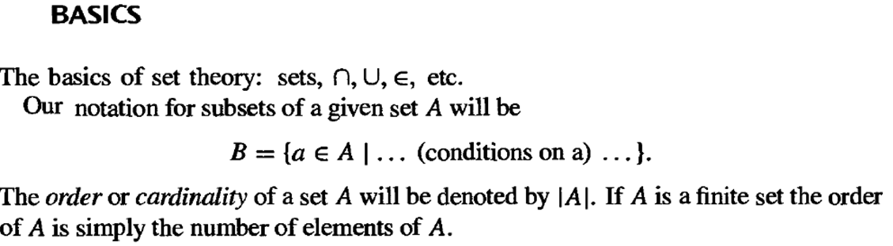

Slide 3
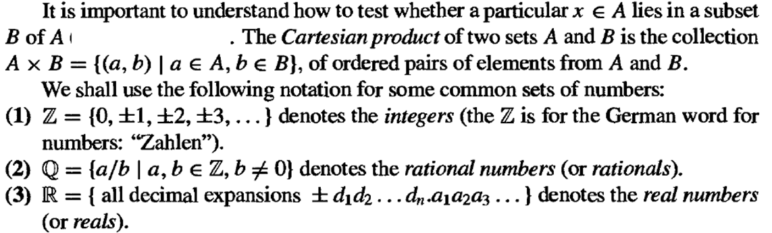

Slide 6
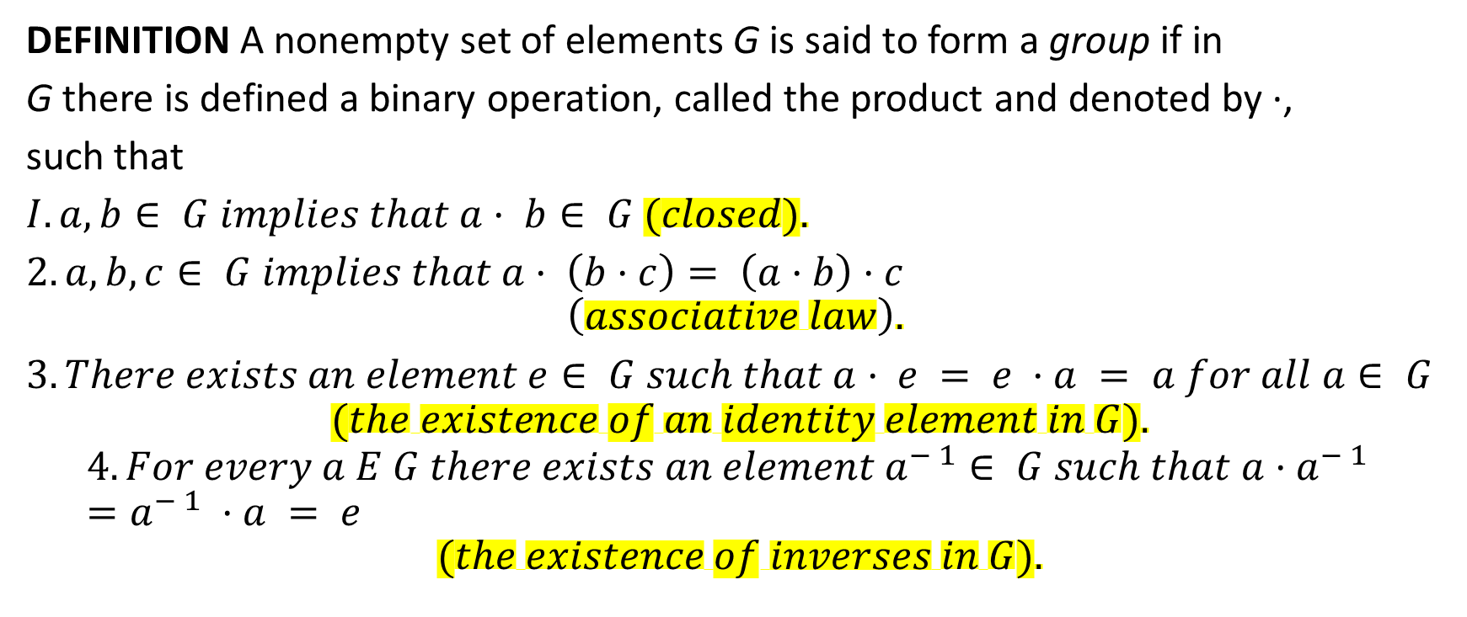
DEFINITION A nonempty set of elements G is said to form a group if in
G there is defined a binary operation, called the product and denoted by ·,
such that
$I. a, b∈ G implies that a· b∈ G (closed).$
$2. a, b, c∈ G implies that a· \left(b·c\right)= \left(a·b\right)·c$
$$\left(associative law\right).$$
$3. There exists an element e∈ G such that a· e = e ·a = a for all a∈ G$
$$(the existence of an identity element in G).$$
$$4. For every a E G there exists an element a^{− 1}∈ G such that a·a^{− 1} =a^{− 1} ·a = e$$
$$(the existence of inverses in G).$$

Slide 7
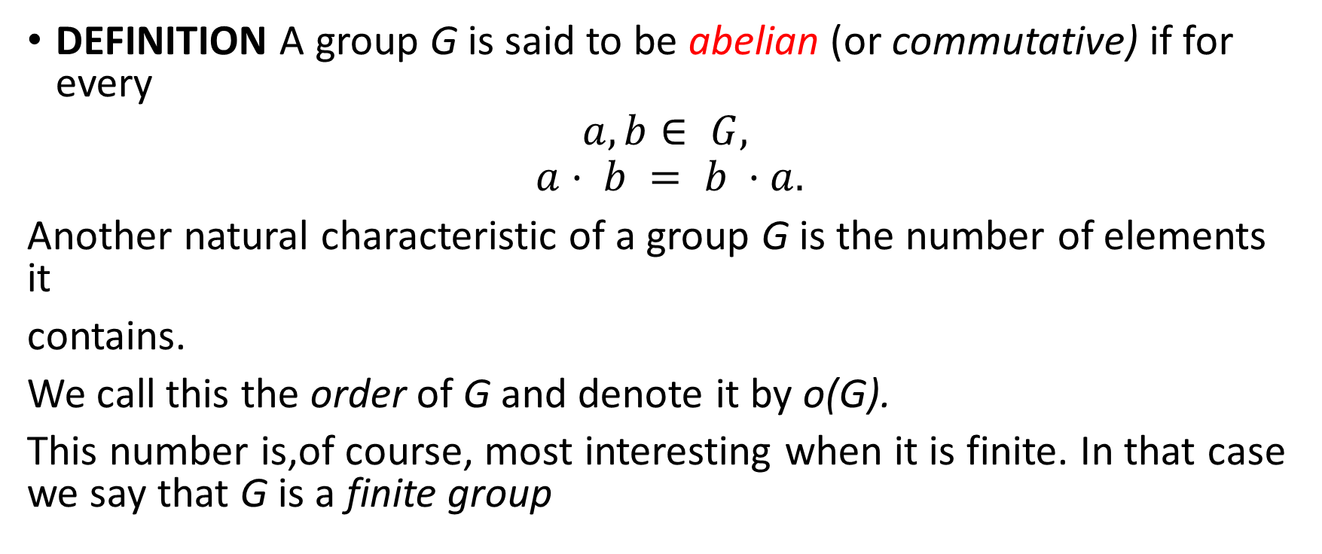
DEFINITION A group G is said to be abelian (or commutative) if for every
$$a, b∈ G,$$
$$a· b = b ·a.$$
Another natural characteristic of a group G is the number of elements it
contains.
We call this the order of G and denote it by o(G).
This number is,of course, most interesting when it is finite. In that case we say that G is a finite group

Slide 8
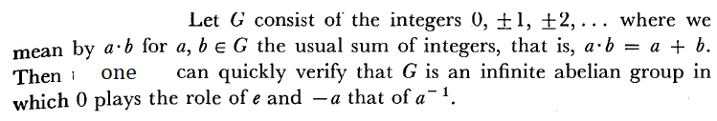
Some Examples of Groups

Slide 9
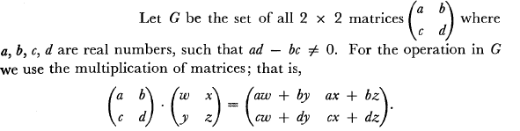
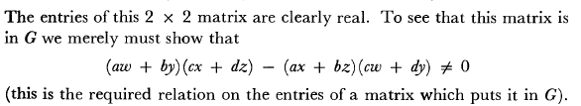

Slide 10


Slide 11
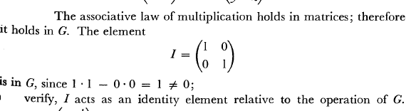

Slide 12
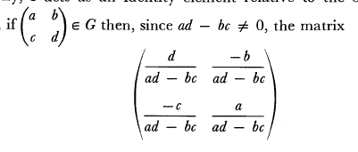

Slide 15
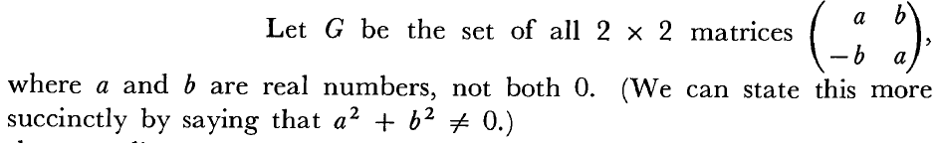
nx

Slide 16
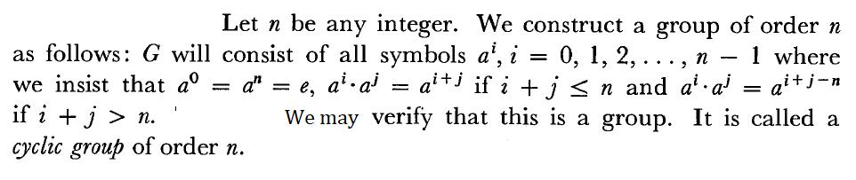

Slide 17
